Slide 1

Exploratory Data Analysis
G2M Insight for Cab Investment Firm
21/10/2023

Slide 2

Agenda
Executive Summary
Problem Statement
Approach
EDA
EDA Summary
Recommendations

Slide 3
Executive Summary
XYZ, a private firm in US, is planning for an investment in the cab industry due to its remarkable growth in recent years.
It is seeking actionable insights to inform their investment decisions. This project aims to provide actionable insights to help XYZ identify the right company for their investment.

Slide 4
Problem Statement
XYZ aims to invest in the cab industry, but they need to understand the market better before making a final decision as per their Go-to-Market (G2M) strategy. Specifically, they want to determine which cab company is a better investment opportunity. To address this, we conducted a comprehensive data analysis.

Slide 5
Approach
Here we merge the datasets 'cab_data' and 'transaction_data' with the 'Transaction ID' column and the customer_data dataset will be merged to it with the 'Customer ID' column. We will form a new dataset 'final_cab_data' with these merged dataset
Here we are not merging city_data dataset to 'final_cab_data' dataset as this won't give any useful insights. Merging makes the values of 'population of the city' and 'no: of cab users in the city' repeated each time in the final_cab_data dataset against the city column
We then perform Exploratory data Analysis in the final_cab_data dataset.

Slide 6
Exploratory Data Analysis
Data analysis covers the period from 31/01/2016 to 31/12/2018, using multiple datasets, including Cab_Data, Customer_ID, Transaction_ID, and City that contains information on 2 cab companies- Yellow Cab and Pink Cab
Final_Cab_Data dataset is formed by merging these datasets
Total Data points: 359392

Slide 7
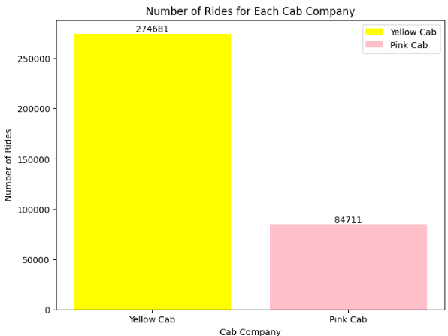
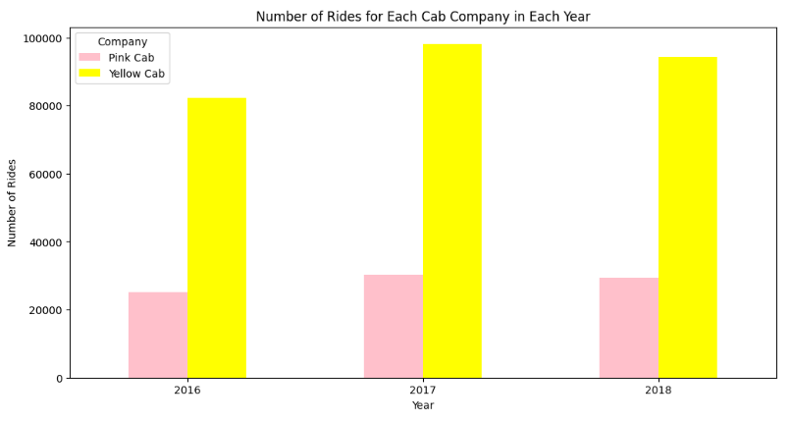
Number of Rides for each Cab Company
Insights:
‘Yellow Cab’ has maximum number of rides compared to pink cab. That means ‘Yellow Cab’ has maximum cab users and most of the cab users prefer to choose services offered by 'Yellow Cab'.
Yellow cab has the highest number of rides in the year 2017.

Slide 8
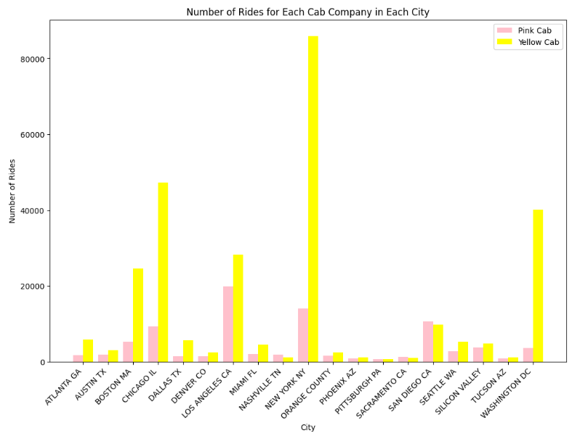
Number of Rides for each Cab Company City Wise
Outliers:
Pink cab has got more number of rides when compared to yellow cabs in cities like
Nashville TN(Pink cab:1841, Yellow cab:1169)
Pittsburgh PA(Pink cab:682, Yellow cab: 631)
Sacramento CA(Pink cab:1134, Yellow cab:1033)
San Deigo CA(Pink cab:10672, Yellow cab:9816)
These exceptions we can ignore when compared to the yellow cab rides in other major cities.

Slide 9
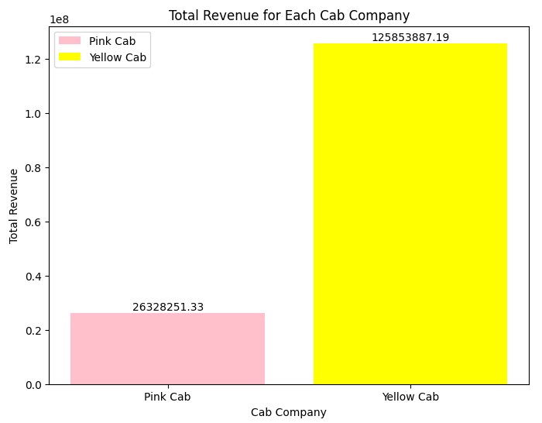
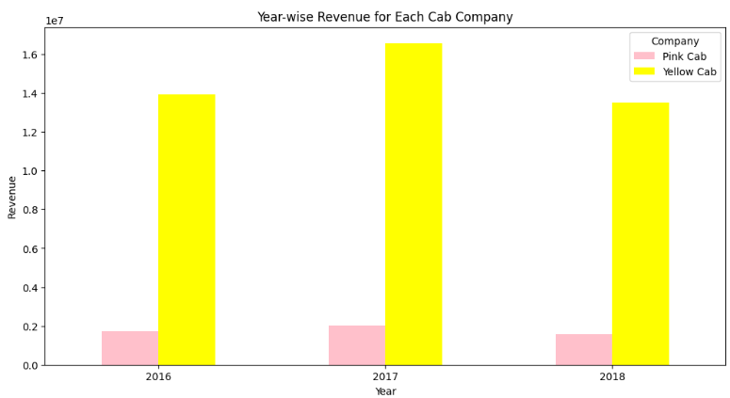
Total Revenue for each Cab Company
Insights:
Yellow Cab has earned more revenue when compared to Pink Cab in each Year.
Yellow Cab has earned more revenue in the year 2017.

Slide 10
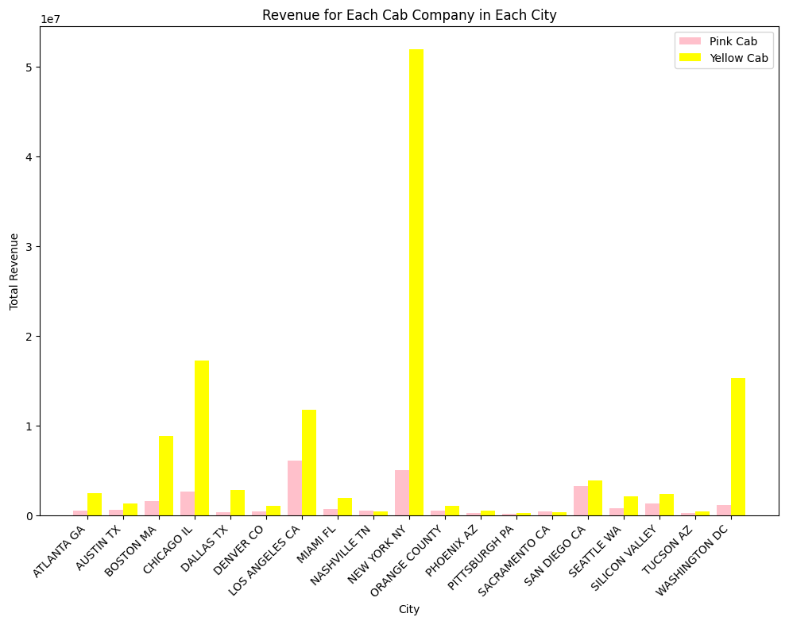
Total Revenue for each Cab Company City Wise
Outliers:
Total Revenue generated by Pink cab is more when compared to yellow cab in cities like
Nashville TN
Pittsburgh PA
Sacramento CA
These exceptions we can ignore when compared to the total revenue generated by yellow cab in other major cities.

Slide 11
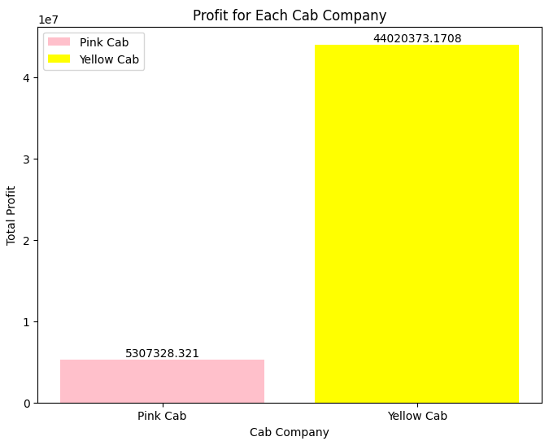
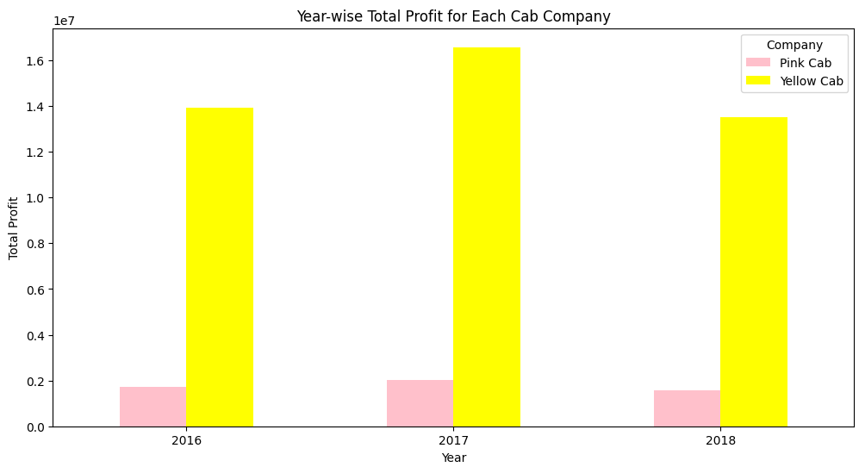
Total Profit for each Cab Company
Insights:
Yellow Cab has earned more profit when compared to Pink Cab in each Year.
Yellow Cab has earned more profit in the year 2017.

Slide 12
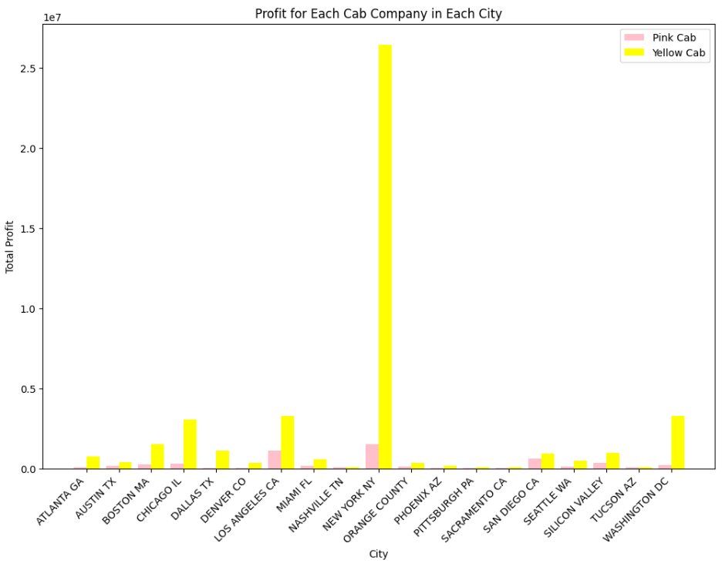
Total Profit for each Cab Company City Wise
Outliers:
Total Profit earned by Pink cab is more when compared to yellow cab in cities like
Nashville TN
Tucson AZ
These exceptions we can ignore when compared to the total profit earned by yellow cab in other major cities.

Slide 13
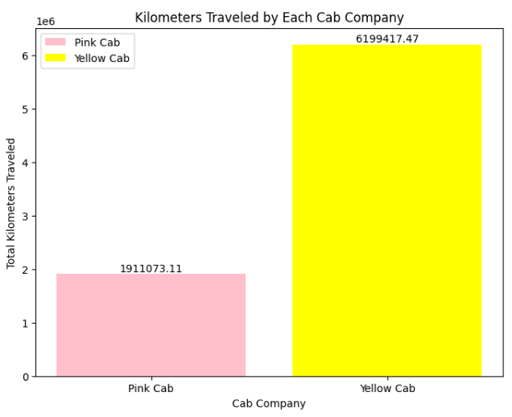
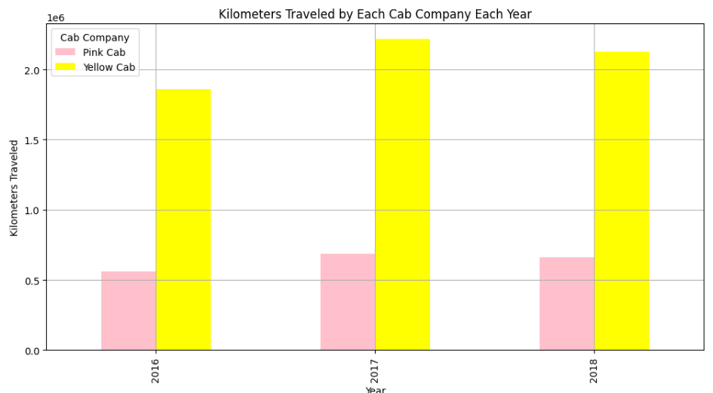
Kilometre Travelled by each Cab Company
Total Profit earned by Pink cab is more when compared to yellow cab in cities like
Nashville TN
Tucson AZ
These exceptions we can ignore when compared to the total profit earned by yellow cab in other major cities.
Total Profit earned by Pink cab is more when compared to yellow cab in cities like
Nashville TN
Tucson AZ
Insights:
Kilometres travelled by 'Yellow Cabs' are more when compared to the 'Pink cab'.

Slide 14
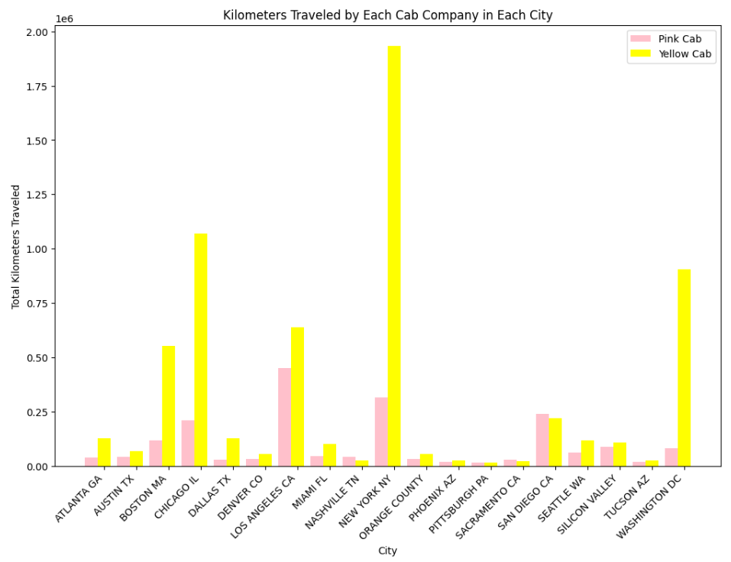
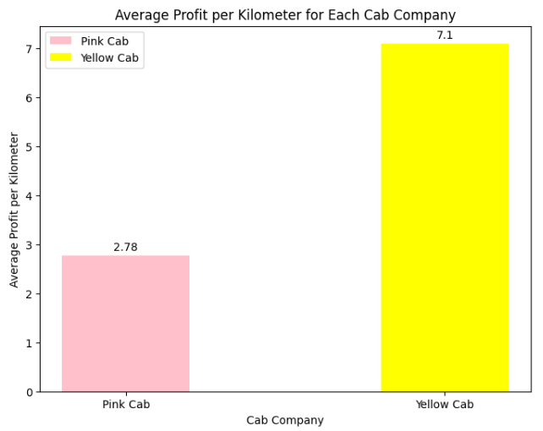
Average Profit per Kilometre
Insights:
Average Profit per Kilometre is greater for Yellow Cab Company

Slide 15
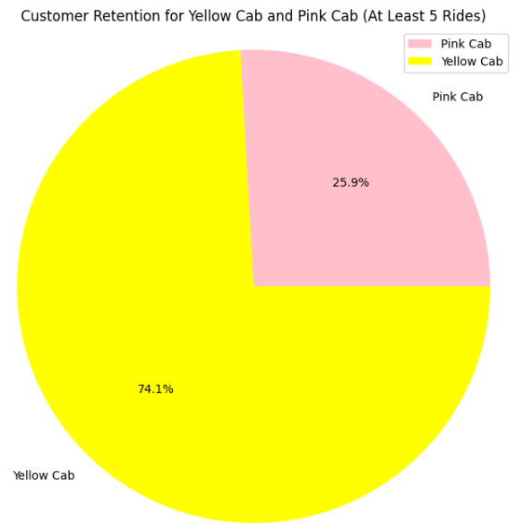
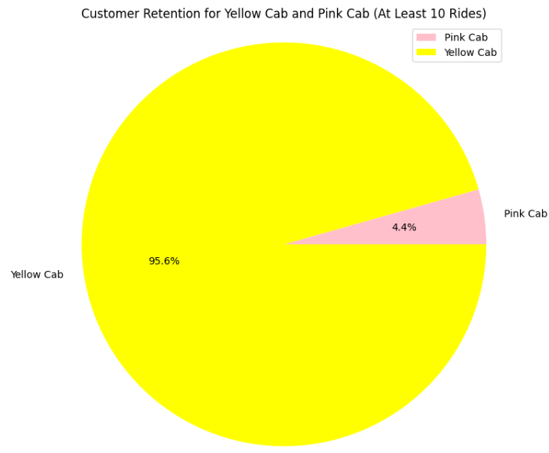
Kilometre Travelled by each Cab Company City Wise
Insights:
Customer Retention is more for choosing services offered by Yellow Cab when they have undergone a journey with it.

Slide 16
EDA Summary & Recommendation
Yellow Cab' has more number of rides compared to 'Pink Cab’. That means most of the cab users prefer to choose services offered by 'Yellow Cab' and it has maximum cab users.
Total Revenue generated by 'Yellow Cabs' are more when compared to the 'Pink cab’.
Total Profit earned by 'Yellow Cabs' are more when compared to the 'Pink cab’.
Kms Travelled by 'Yellow Cabs' are more when compared to the 'Pink cab’.
Profit per Km of 'Yellow Cabs' are more when compared to the 'Pink cab’.
Customers prefer to choose 'Yellow Cabs' during their next journey once they have undergone a ride with it. Customer Retention is more.
Recommendation
I recommend that XYZ company should invest in 'Yellow Cab' company to gain more profit
In the cities with the exceptions, we need to focus on services offered to customers to get more rides for the Yellow cabs.

Slide 17
.
Thank You

